Slide 1
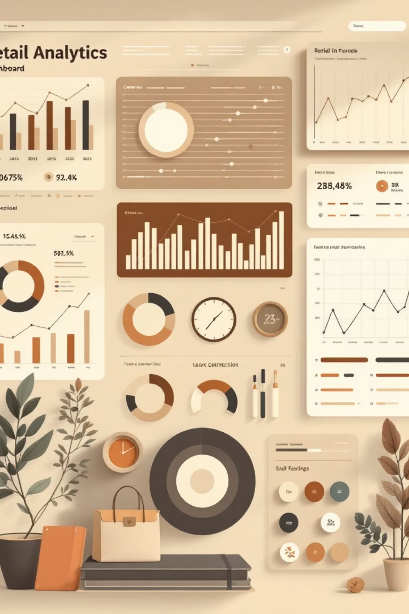
Customer Shopping Behavior Analysis
Uncovering insights from 3,900 purchases to guide strategic business decisions

Slide 2

Dataset Overview
3,900
18
50
$59.76
Total Purchases
Data Points
Locations
Avg Purchase
Transactions analyzed across all categories
Features tracking demographics and behavior
Geographic distribution of customers
Mean transaction value

Slide 3
Data Preparation Journey
01
02
03
Data Loading
Exploration
Cleaning
Imported dataset using pandas for analysis
Examined structure and summary statistics
Imputed 37 missing review ratings by category median
04
05
Feature Engineering
Database Integration
Created age groups and purchase frequency metrics
Loaded cleaned data into PostgreSQL

Slide 4
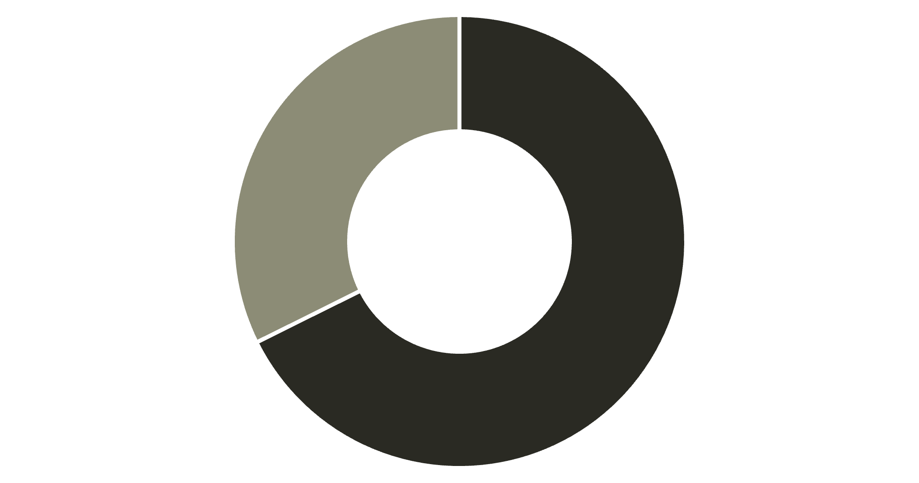
Revenue Insights by Gender
Male Dominance
Male customers generate 68% of total revenue, significantly outpacing female shoppers
Strategic opportunity to boost female engagement through targeted campaigns
Male
Female

Slide 5

Top-Rated Products
Gloves
Sandals
Boots
3.86 rating
3.84 rating
3.82 rating
Hat
Skirt
3.80 rating
3.78 rating
Highlight these customer favorites in marketing campaigns to drive conversions

Slide 6

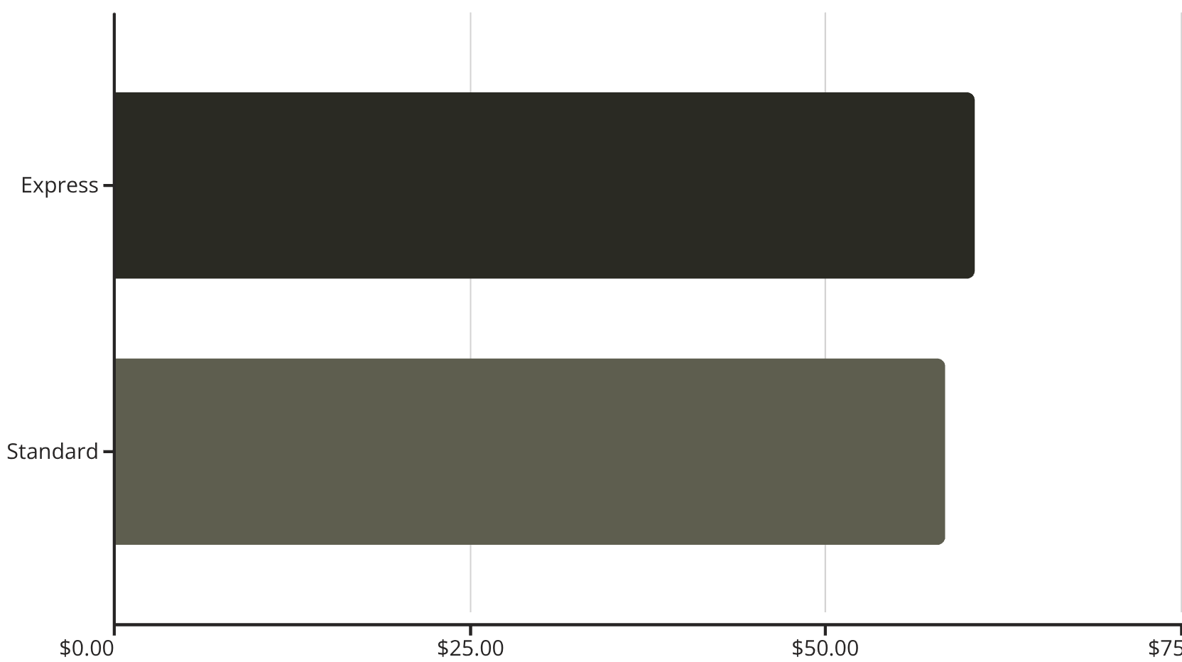
Shipping & Spending Patterns
Express vs Standard
Express shipping customers spend $2 more per order on average

Slide 7



Subscription Status Analysis
27%
73%
Subscribers
Non-Subscribers
1,053 customers with active subscriptions
2,847 customers without subscriptions
Revenue Breakdown
Opportunity: Promote exclusive subscriber benefits to convert the 73% non-subscriber base and boost recurring revenue
Subscribers: $62,645 total
Non-subscribers: $170,436 total
Average spend nearly identical: ~$59.50

Slide 8



Customer Segmentation
New
1
83
2
Returning
701
3
Loyal
3,116
Based on purchase history, 80% of customers are loyal with multiple purchases
Repeat Buyer Insight
958 subscribers have 5+ purchases vs 2,518 non-subscribers

Slide 9
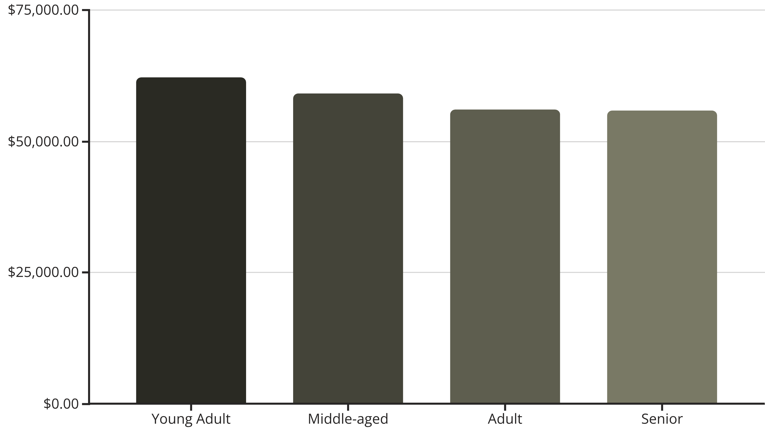
Revenue by Age Group
Young adults lead revenue generation—focus marketing efforts on this high-value demographic

Slide 10
Strategic Recommendations
Boost Subscriptions
Loyalty Programs
Review Discount Policy
Promote exclusive benefits to convert 73% non-subscriber base
Reward repeat buyers to strengthen the 80% loyal segment
Balance promotional sales with margin control—839 high spenders used discounts
Product Positioning
Targeted Marketing
Highlight top-rated items (Gloves, Sandals, Boots) in campaigns
Focus on young adults and express-shipping users for maximum ROI

